Slide 1
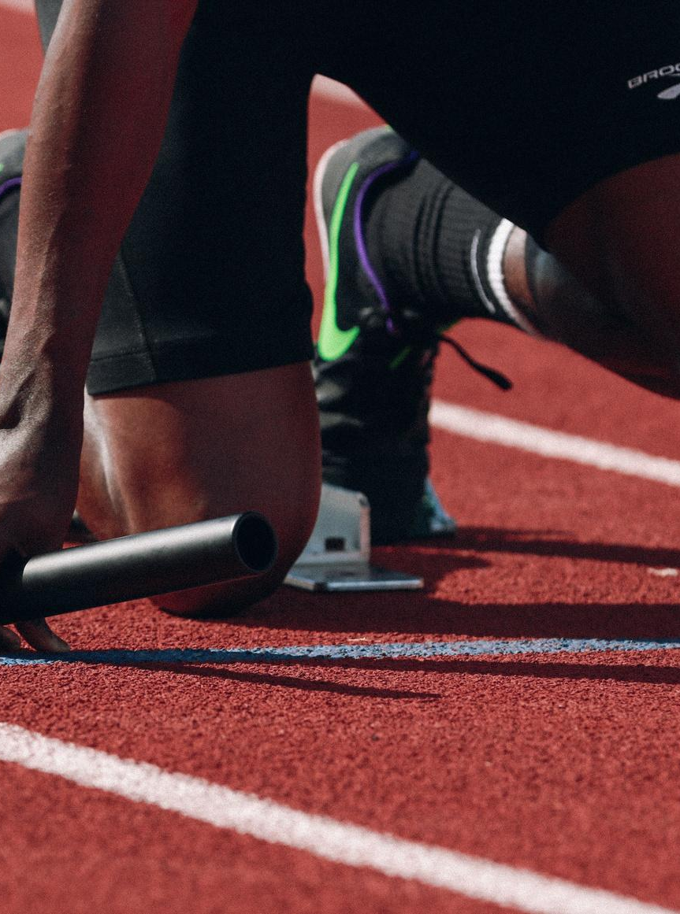
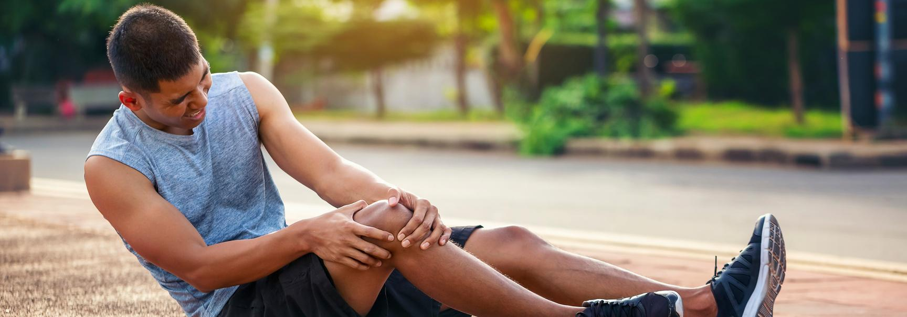
INJURY PREDICTION FOR ATHLETES
HDSC PREMIERE PROJECT
TEAM NEURAL NETWORK
29TH OCTOBER 2022

Slide 2
PRESENTERS
Egbaidomeh Daniel Ehiz
PRESENTER 1
Daniel Kurui
PRESENTER 2

Slide 3

AGENDA
01
02
03
INTRODUCTION
PROBLEM
STATEMENT
APPROACH
04
05
06
EDA
MODEL BUILDING AND DEPLOYMENT
CONCLUSION

Slide 4
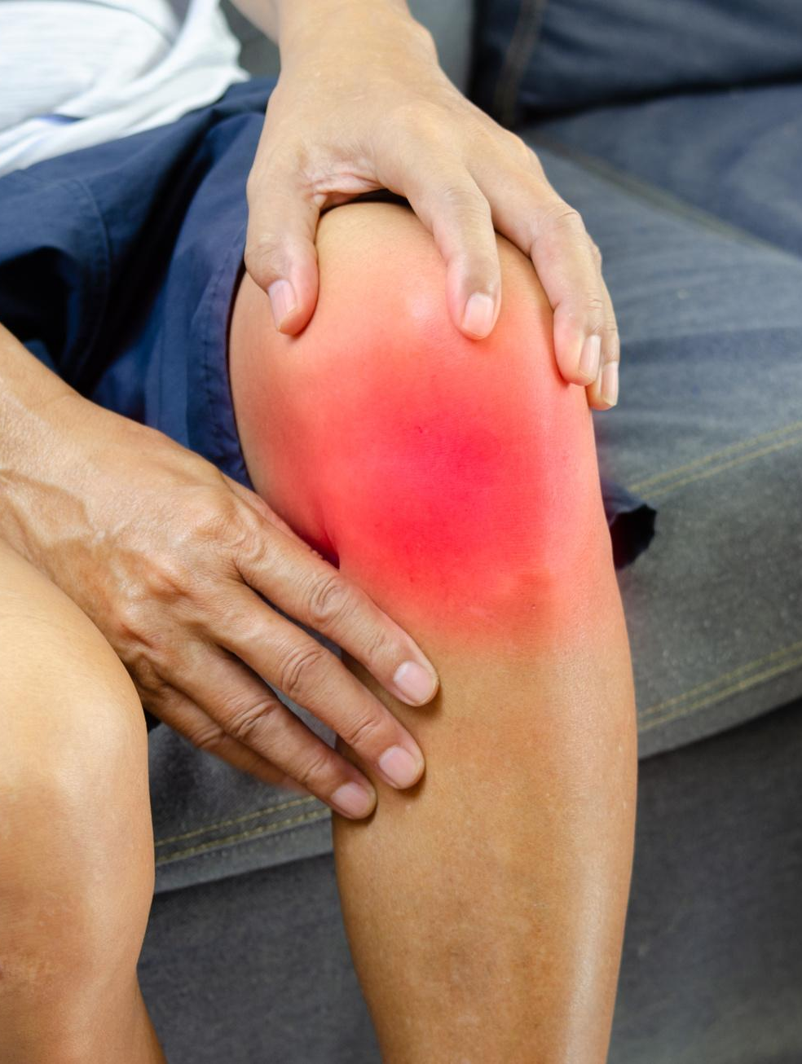
INTRODUCTION
Injuries are common in sports and can have significant physical, psychological and financial consequences.Machine learning (ML) methods could be used to improve injury prediction and allow proper approaches to injury prevention.

Slide 5

OBJECTIVE
The aim of our study was therefore to develop a machine learning model that can predict injury occurrences based on how the training regimen of an athlete

Slide 6

WE BUILT 3 MACHINE LEARNING MODELS TO PREDICT INJURY OCURRENCES AND DEPLOYED BEST PERFORMING MODEL IN TERMS OF ACCURACY AND PRECISION.
•Deep Learning Neural Network (DNN)
•Extreme Gradient Boosting (XGBoost)
•K - Nearest Neighbours (KNN)
OUR APPROACH

Slide 7
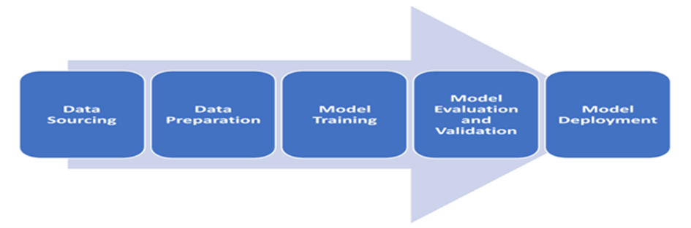
WORK FLOW

Slide 8

DATA SOURCE
TWO DATASETS WERE USED FOR ANALYSIS AND MODEL DEPLOYMENT IN THIS PROJECT WAS OBTAINED FROM KAGGLE
DAILY DATASET
WEEKLY DATASET

Slide 9
EXPLORATORY DATA ANALYSIS

Slide 10
DATA DESCRIPTION
THE TWO DATASETS CONTAIN A TOTAL OF 42766 OBSERVATIONS IN 73 COLUMNS EACH.
THE NUMBER OF TRAINING SESSIONS AN ATHLETE HAD OVER A PERIOD OF 3.5 YEARS.
THE DAILY APPROACH CONTAINED TRAINING INFORMATION ABOUT ATHLETES FOR EVERY 7 DAYS
THE WEEKLY DATASET CONTAINED 28 UNIQUE COLUMNS WITH 22 REPEATING 3 TIMES DENOTING 3 WEEKS OF TRAINING BEFORE THE EVENT OF INJURY

Slide 11
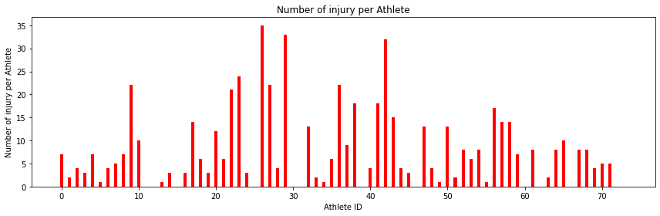
COUNTPLOT
from the above graph, the Athlete with ID number 26 has the most highest number of injuries with about 35.

Slide 12
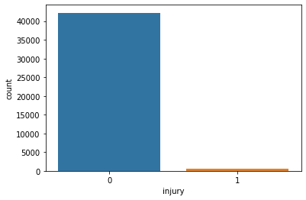
COUNTPLOT
There are total records of 42223 (98.6%) times an athlete didn't got injured, and 575 (1.4%) times an athlete got injured

Slide 13
MODELLING
BUILDING

Slide 14
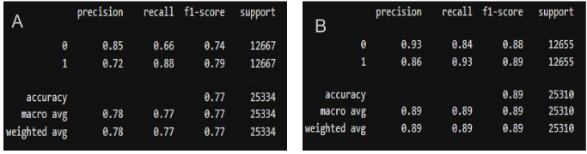
Deep Neural Network (DNN) Model.
Performance of DNN model for the weekly and daily approaches
A. Daily Approach
B. Weekly Approach

Slide 15
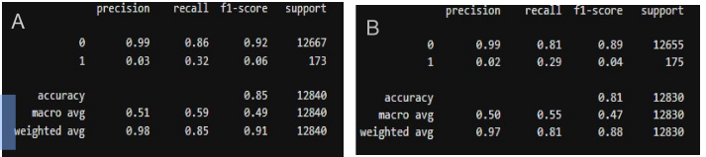
Extreme Gradient Boosting (XGBoost) Model
Performance of XGBoost model for the weekly and daily approaches
A. Daily Approach
B. Weekly Approach

Slide 16
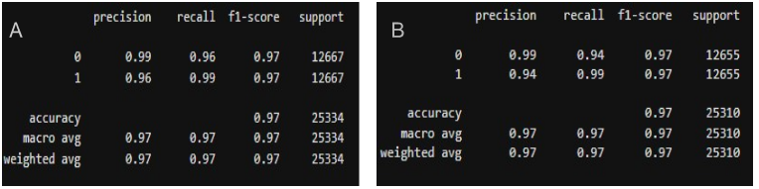
K - Nearest Neighbours (KNN) Model
Performance of KNN model for the weekly and daily approaches
A. Daily Approach
B. Weekly Approach

Slide 17
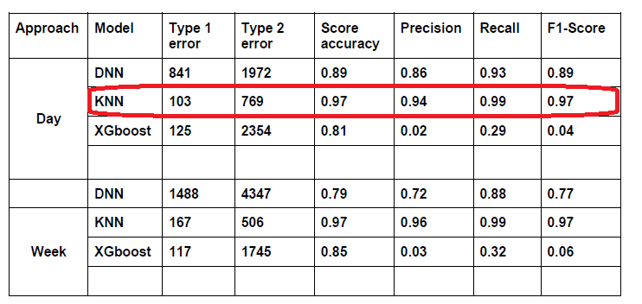
RESULT ANALYSIS

Slide 18
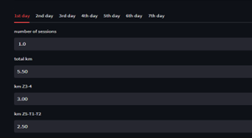
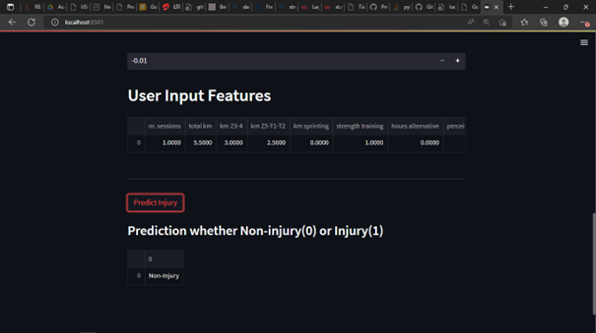
To demonstrate consumption of the developed model, the generated K-NN model was deployed using a streamlit cloud framework.
MODEL DEPLOYMENT

Slide 19
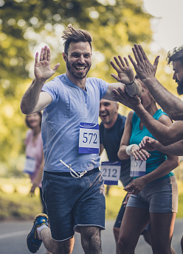
CONCLUSION
We built three models, the DNN, K-NN and XGBoost. We discovered that the best-performing model on the two datasets is K-NN with an accuracy of 97%. The K-NN model was then deployed to predict injury occurrences in order to allow development of proper approaches to injury prevention for athletes.

Slide 20

LIMITATIONS
Huge Data Imbalance
Collaboration
Time Contrains

Slide 21
THANK YOU

